Slide 1
SOGIESC Workshop
Christian James E. Barimbao
January 31, 2024
Video and Image Processing Laboratory
Main reference: https://rainbowresearchhub.up.edu.ph/resources/
Notes:
Bakit sogieSC? Not Sogie-SC
Everyone has SOGIESC

Slide 2
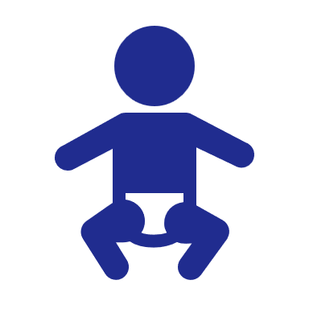


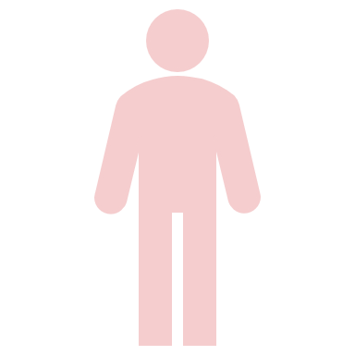
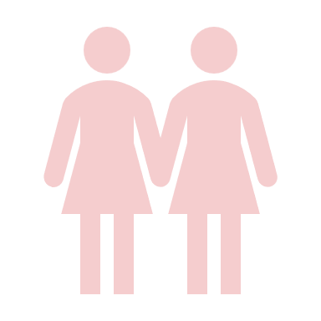
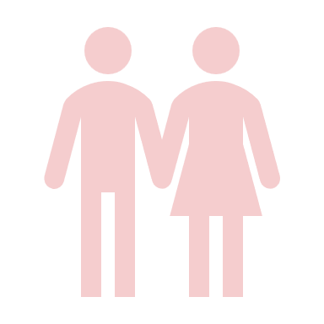
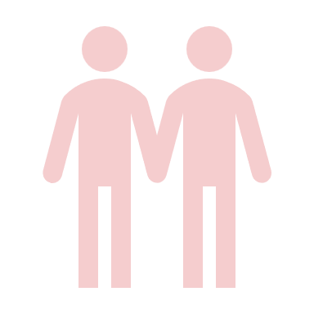
What is your sex?

Slide 3
SoGIEsC (Sex Characteristics)
INTERSEX
used to be called
Hermaphrodite, this is now outdated
- Anatomical distinctions of biological sex.
FEMALE
(XX chromosomes, vagina, ovaries,
higher levels of estrogen and progesterone, etc.)
MALE
(XY chromosomes, penis, testes,
higher levels of testosterone, etc.)
Notes:
Anatomical – structural identification of our body
Government documents
Sex vs Gender
Assigned sex at birth nung tayo ay pinanganak, cert of live birth
Scienitific inaccurateness of hermaphroditism

Slide 4
SoGIEsC (Sex Characteristics)
Can be categorized to primary (reproductive) or secondary characteristics (develops at maturity).
At birth we are assigned a sex (based usually on primary SC).
© UP CWGS SOGIESC Primer (2022)

Slide 5
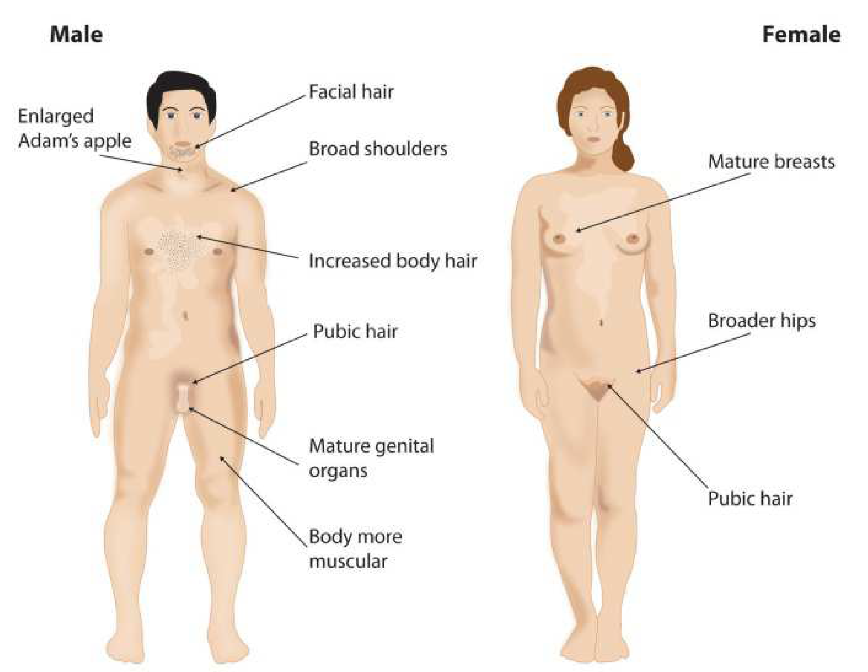
SoGIEsC (Sex Characteristics)
© UP CWGS SOGIESC Primer (2022)
Notes:
Assigned sex at birth classification based on primary sex characteristics
Pwedeng mali, kasi tao lang din ang nag aassign
Why sinama ang SC? To include Intersex siblings.

Slide 6
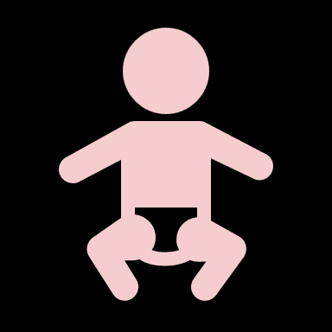



What are you?

Slide 7
(Gender identity, and Gender expression)
SoGIEsC
GI – Internal
GE – External

Slide 8
SoGIEsC
Gender identity
Sex VS Gender:
Sex is anatomical.
Gender is a social construct.

Slide 9
SoGIEsC
Gender identity
Sex VS Gender:
Gender is a social construct.
Sex
Male
Female
Intersex
Gender
Man
Woman
Other Genders

Slide 10
SoGIEsC
Gender identity
Some adjectives to describe gender:
Gender norms
Assigned Sex at Birth
Cisgender
Transgender

Slide 11
SoGIEsC
Gender identity
Some adjectives to describe gender:
Gender norms
Gender
Identity
Assigned Sex at Birth
Cisgender
Transgender

Slide 12
SoGIEsC
Gender identity
Some adjectives to describe gender:
Gender norms
Gender
Identity
Assigned Sex at Birth
Cisgender
Transgender

Slide 13
SoGIEsC
Gender identity
Some adjectives to describe gender:
Cisgender
Cis woman
Cis man
Transgender
Queer
Gender norms
Gender
Identity
Assigned Sex at Birth
F
M

Slide 14
SoGIEsC
Gender identity
Some adjectives to describe gender:
Cisgender
Transgender
Trans woman
Trans man
Queer
Gender norms
Gender norms
Gender
Identity
Assigned Sex at Birth
Opposite Sex
F
M

Slide 15
SoGIEsC
Gender identity
Some adjectives to describe gender:
Cisgender
Transgender
Queer/Non-binary
Gender norms
Gender norms
Assigned Sex at Birth
Opposite Sex
Gender
Identity

Slide 16
SoGIEsC
Gender identity
Some adjectives to describe gender:
Cisgender
Transgender
Queer/Non-binary
Agender
Bigender
Genderfluid
Babaylan / Katalonan
Two-spirit
Gender norms
Gender norms
Assigned Sex at Birth
Opposite Sex
Gender
Identity
Notes:
Agender – no gender
Bigender – two genders
Genderfluid – changing experience
Genderqueer / queer – radical and transgressive term, to reject gender norms
Two-Spirit (Various Indigenous Tribes in North America): The term "Two-Spirit" is often used by some Indigenous tribes in North America to describe a person who embodies both masculine and feminine qualities or occupies a gender role outside the traditional binary. The specific roles and responsibilities associated with Two-Spirit individuals can vary among tribes.
Babaylan / Katalonan – Filipino shamans. Healers/spiritual leaders during pre-colonial times, only women were allowed. Men who are chosen as spiritual leaders will have to live the life of a woman, some even had male partners.
Hijra (South Asia): While not specific to indigenous tribes, the Hijra community in South Asia has existed for centuries. Hijras are considered a third gender in South Asian cultures, encompassing individuals who may be intersex, transgender, eunuchs, or simply not conforming to the binary gender system.
Fa'afafine (Samoa): In Samoan culture, the term "fa'afafine" refers to individuals who identify outside the traditional male/female binary. Fa'afafine are recognized and accepted as a distinct gender category with roles and responsibilities in Samoan society.
Berdache (Various Indigenous Tribes): The term "berdache" has been historically used by anthropologists to describe gender-diverse individuals in some Indigenous tribes. However, its use has been criticized, and many prefer the term Two-Spirit for more accurate and culturally respectful representation.

Slide 17
SoGIEsC
Gender identity
Some adjectives to describe gender:
Cisgender
Transgender
Queer/Non-binary
Agender
Bigender
Genderfluid
Babaylan / Katalonan
Two-spirit
Gender norms
Gender norms
Assigned Sex at Birth
Opposite Sex
Gender
Identity
Notes:
Agender – no gender
Bigender – two genders
Genderfluid – changing experience
Genderqueer / queer – radical and transgressive term, to reject gender normsBabaylan / Katalonan – Filipino shamans. Healers/spiritual leaders during pre-colonial times, only women were allowed. Men who are chosen as spiritual leaders will have to live the life of a woman, some even had male partners.
Two-Spirit (Various Indigenous Tribes in North America): The term "Two-Spirit" is often used by some Indigenous tribes in North America to describe a person who embodies both masculine and feminine qualities or occupies a gender role outside the traditional binary. The specific roles and responsibilities associated with Two-Spirit individuals can vary among tribes.
Hijra (South Asia): While not specific to indigenous tribes, the Hijra community in South Asia has existed for centuries. Hijras are considered a third gender in South Asian cultures, encompassing individuals who may be intersex, transgender, eunuchs, or simply not conforming to the binary gender system.
Fa'afafine (Samoa): In Samoan culture, the term "fa'afafine" refers to individuals who identify outside the traditional male/female binary. Fa'afafine are recognized and accepted as a distinct gender category with roles and responsibilities in Samoan society.
Berdache (Various Indigenous Tribes): The term "berdache" has been historically used by anthropologists to describe gender-diverse individuals in some Indigenous tribes. However, its use has been criticized, and many prefer the term Two-Spirit for more accurate and culturally respectful representation.

Slide 18
What do you like to wear?

Slide 19
SoGIEsC Gender expression
Neutral
Androgynous
Queer
Non-Conforming
Womanly/
Feminine
Male/
Masculine
How we express ourselves
How others perceive us
Notes:
Dito papasok ang sogie equality bill for straights
Nabubully ang mga bata based on their GEs.
Dito nagmumula ang stigma.

Slide 20
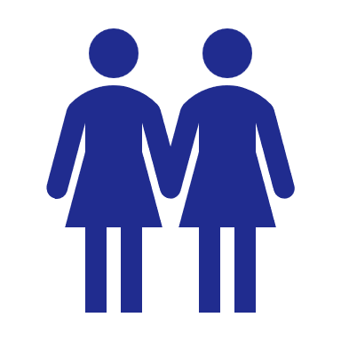
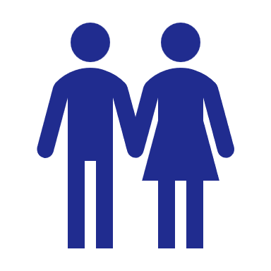
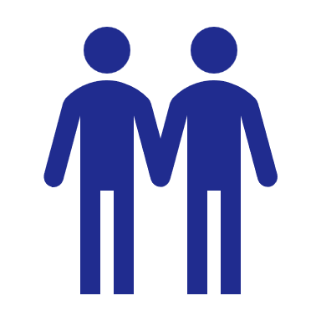
To whom are you attracted to?
Notes:
1. Desire / Pagnanasa. Not defined by your sex activities.

Slide 21
SoGIEsC (Sexual orientation, adj.)
Level of attraction
Same gender
(Homosexual)
No attraction
(Asexual)
Different gender
(Heterosexual)
Heterosexual / Straight*

Slide 22
SoGIEsC (Sexual orientation)
Gay, Lesbian / Homosexual*
Level of attraction
Same gender
(Homosexual)
No attraction
(Asexual)
Different gender
(Heterosexual)

Slide 23
SoGIEsC (Sexual orientation)
Level of attraction
Same gender
(Homosexual)
No attraction
(Asexual)
Different gender
(Heterosexual)
Bisexual+
Notes:
1. Pansexual

Slide 24
SoGIEsC (Sexual orientation)
Level of attraction
Same gender
(Homosexual)
No attraction
(Asexual)
Different gender
(Heterosexual)
Bisexual+
Bisexual, Pansexual, Demisexual, Sexually fluid, Queer

Slide 25
SoGIEsC (Sexual orientation)
Level of attraction
Same gender
(Homosexual)
No attraction
(Asexual)
Different gender
(Heterosexual)

Slide 26
To SUMMARize Everyone has sogiesc
What is your sex? (SC)
What are you? (GI)
What do you like to wear? (GE)
To whom are you attracted to? (SO)
Notes:
Everyone has SOGIESC

Slide 27
THANK YOU!

Slide 28
How to be gender sensitive?
Notes:
Everyone has SOGIESC

Slide 29
1. Do not assume someone’s sogiesc
Not our business.
Sexual activities ≠ Sexual Orientation.
Notes:
Everyone has SOGIESC

Slide 30
2. Respect pronouns / lived names
If you do not know, observe first, ask someone they know, or establish an inclusive space. Else, try to use gender neutral language.
Correct someone you know if they misgender another person (be an ally).
Notes:
Everyone has SOGIESC

Slide 31
3. Never ‘out’ someone
Also be patient with a person who is Questioning
Notes:
Everyone has SOGIESC

Slide 32
4. Be careful not to give backhanded compliments
Notes:
Everyone has SOGIESC

Slide 33
5. Support gender inclusive spaces / initiatives
Notes:
Everyone has SOGIESC

Slide 34
6. Know your limits as an ally
Notes:
Everyone has SOGIESC

Slide 35
7. Use gender affirmative terms
(see supplementary material)
Notes:
Everyone has SOGIESC

Slide 36
THANK YOU!

